Slide 1
27장 (1) Spark core concepts, architecture, and Internals
2019. 1학기
Jeong Joon Lee

Slide 2
4.1 Core Concepts
참고:
http://datastrophic.io/core-concepts-architecture-and-internals-of-apache-spark/
Book: Learning Apache Spark
The jargon of Apache Spark
Job: A piece of code which reads some input from HDFS or local, performs some computation on the data and writes some output data.
Stages:
Jobs are divided into stages. Stages are classified as a Map or reduce stages (Its easier to understand if you have worked on Hadoop and want to correlate).
Stages are divided based on computational boundaries.
All computations (operators) cannot be updated in a single stage.
It happens over many stages.
Tasks:
Each stage has some tasks, one task per partition.
One task is executed on one partition of data on one executor (machine).
DAG: DAG stands for Directed Acyclic Graph, in the present context its a DAG of operators.
Executor: The process responsible for executing a task.
Master: The machine on which the Driver program runs
Slave: The machine on which the Executor program runs

Slide 3
Spark Overview
Spark is a generalized framework for distributed data processing providing functional API for manipulating data at scale, in-memory data caching and reuse across computations.
Spark is built around the concepts of Resilient Distributed Datasets and Direct Acyclic Graph representing transformations(i.e., processing) and dependencies between them.
Spark Application is often referred to as Driver Program or Application Master.
Spark Application = Spark Context + user code which
Create RDD
Perform series of transformations to achieve final result.
These transformations of RDDs are then translated into DAG and submitted to Scheduler to be executed on set of worker nodes.

Slide 5
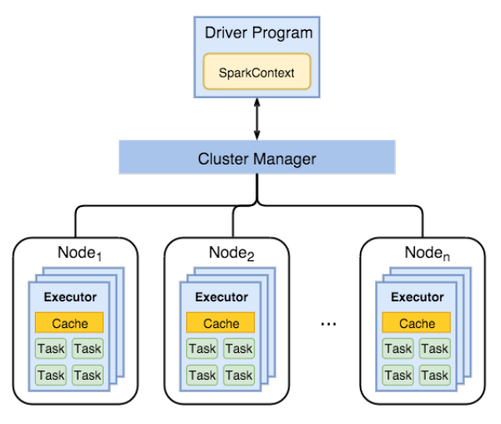
4.2 Spark Components
(1) Overall Architecture

Slide 6
Spark Driver
separate process to execute user applications
creates SparkContext to schedule jobs execution and negotiate with cluster manager
Executors
run tasks scheduled by driver
store computation results in memory, on disk or off-heap
interact with storage systems
Cluster Manager
Mesos
YARN
Spark Standalone

Slide 7
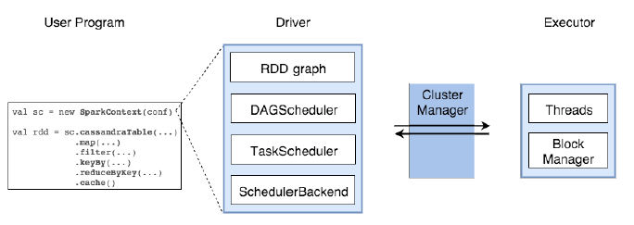
(2) Components in Spark Driver
SparkContext
represents the connection to a Spark cluster, and can be used to create RDDs, accumulators and broadcast variables on that cluster
DAGScheduler
computes a DAG of stages for each job
submits them to TaskScheduler
determines preferred locations for tasks (based on cache status or shuffle files locations)
finds minimum schedule to run the jobs

Slide 8
TaskScheduler
responsible for sending tasks to the cluster, running them, retrying if there are failures, and mitigating stragglers
SchedulerBackend
backend interface for scheduling systems that allows plugging in different implementations(Mesos, YARN, Standalone, local).
BlockManager
provides interfaces for putting and retrieving blocks both locally and remotely into various stores (memory, disk, and off-heap)

Slide 9
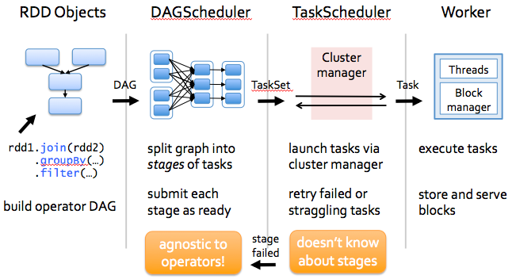
4.3 How Spark works ?
Process of working

Slide 10
As you enter your code in spark console (creating RDD’s and applying operators),Spark creates a operator graph.
When the user runs an action (like collect), the Graph is submitted to a DAG Scheduler.
The DAG scheduler
divides operator graph into (map and reduce) stages.
A stage is comprised of tasks based on partitions of the input data.
pipelines operators together to optimize the graph.
For e.g. Many map operators can be scheduled in a single stage.
This optimization is key to Sparks performance.
The final result of a DAG scheduler is a set of stages.
The stages are passed on to the Task Scheduler.
The task scheduler
launches tasks via cluster manager. (Spark Standalone/Yarn/Mesos).
The task scheduler doesn’t know about dependencies among stages.

Slide 11
Q&A

